Slide 1
MCB 638
Live Session 8
Monday

Slide 2
Agenda for Live Session 8
Process Learnings/Tips
Control charts
Project Rubric
Wrap-up/What’s next/Feedback

Slide 3
Process Learnings/Tips
If you have questions about your data or your project, please join Office Hours – on Weds this week or reach out by e-mail.
Remember to label your work with your name and #1 – 10 in Excel on the Homework from Understanding Variation. I recommend reading and answering the questions literally.
Control chart convention is that if you are doing Xbar/R, Xbar/s or IMR charts, you would create two separate charts (rather than put both charts on the same graph)
Reminder that your final PowerPoint needs to be less than 16 mb to successfully upload to 2SU. You may need to Copy/Paste Special/Enhanced Metafile or picture and may also zip your file. Please no pdfs.
Please take a few minutes to complete the course evaluation.
The final is during Live Session 11 on Dec 14.

Slide 4
Control Charts (Process Behavior Charts)
All processes have variation.
Control charts help you see the type of variation in your process
One of the most common use of control charts is to monitor a process
Common cause: predictable, routine, stable; noise
Special cause: unpredictable, unstable, out of control; a signal
If a control chart indicates special cause variation, something needs fixing/investigating
What are some common cause and special cause variations in your processes?

Slide 5
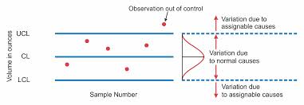
Control Charts (Process Behavior Charts)
Elements of a control chart:
Centerline = average
Control Limits:
UCL (upper control limit) LCL (lower control limit)
Control Limits are +/- 3 Std Dev from the Center Line
y = your metric, process output
x = your subgrouping plan (usually time)
When a process is “in control” does this mean that it’s a good process? Give an example to explain

Slide 6
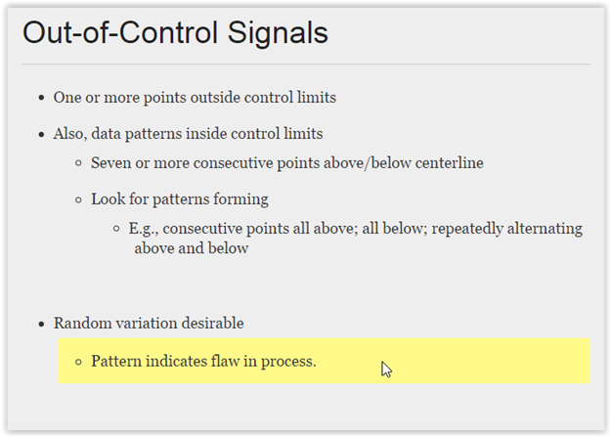
Control Charts - Signals

Slide 7
Control Charts - Signals
How many points in a row in a sawtooth pattern would be considered a signal/out of control?
Per Western Electric Decision Rules: 14 consecutive points alternating up and down – the process would be considered out of control

Slide 8
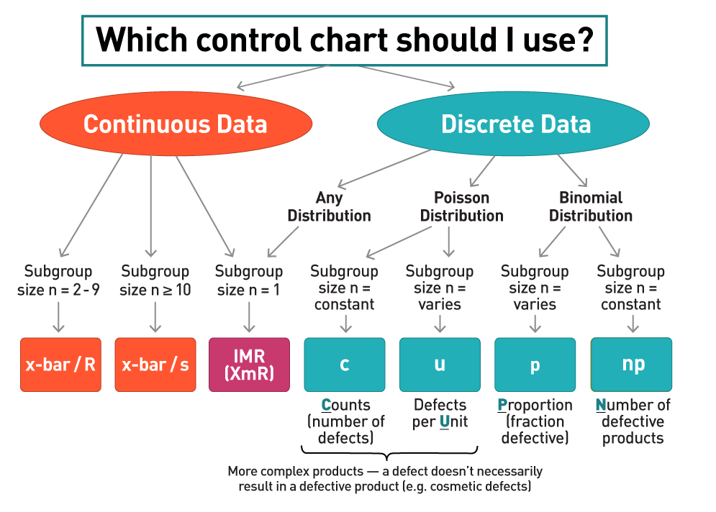
Which Control Chart should I use?

Slide 9
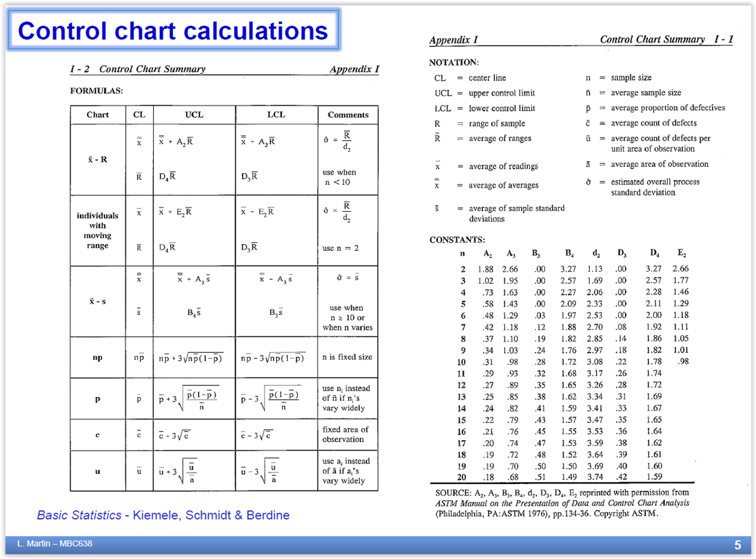
Note:
On this chart
n=subgroup size

Slide 10

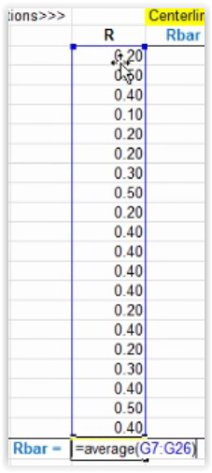
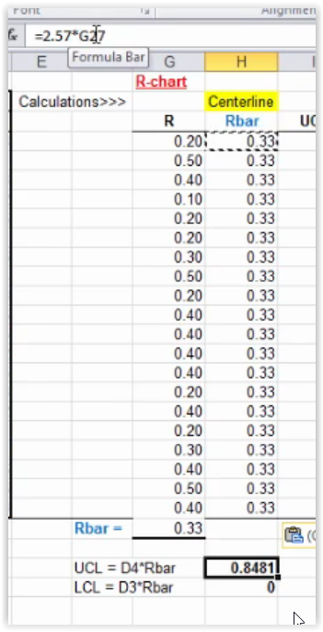
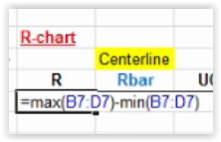
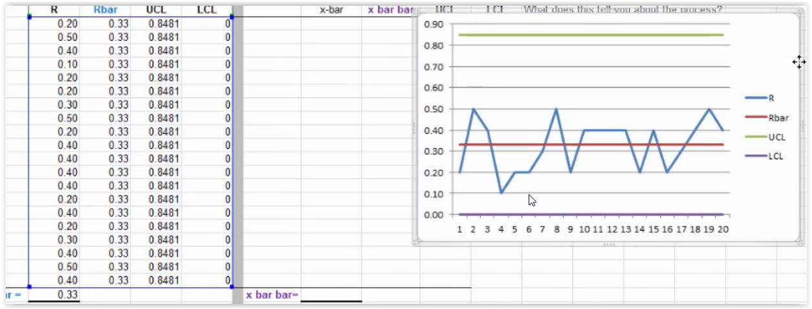
How to Build X-bar/R in Excel
3– Fill your column
1 – Calc Range
2 – Calc Avg Range, R Bar
4– Calc UCL and LCL based on subgroup size
6– Insert ->Line – first chart to Graph
5– Fill your columns for UCL LCL

Slide 11
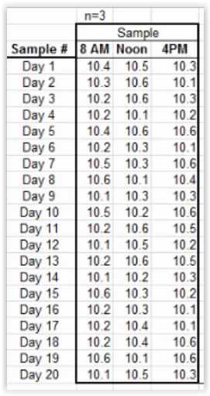
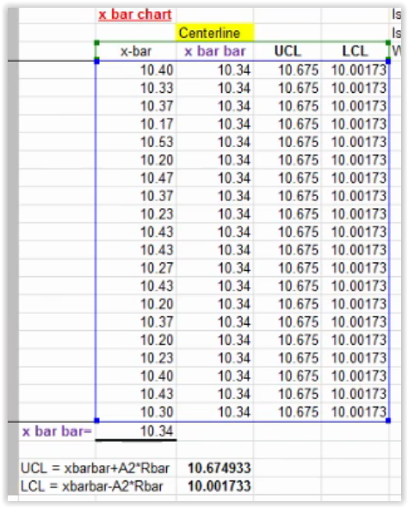
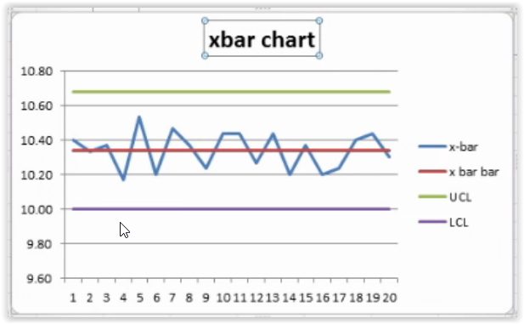
How to Build X-bar/R in Excel
Subgroup size
X Bar Chart
1 – Calc avg.
4 – Fill Data
6– Insert ->Line – first chart to Graph
2 – Calc avg of avgs
3 – Calc UCL and LCL based on n=3

Slide 12
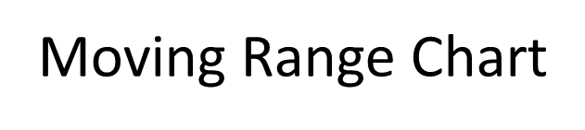
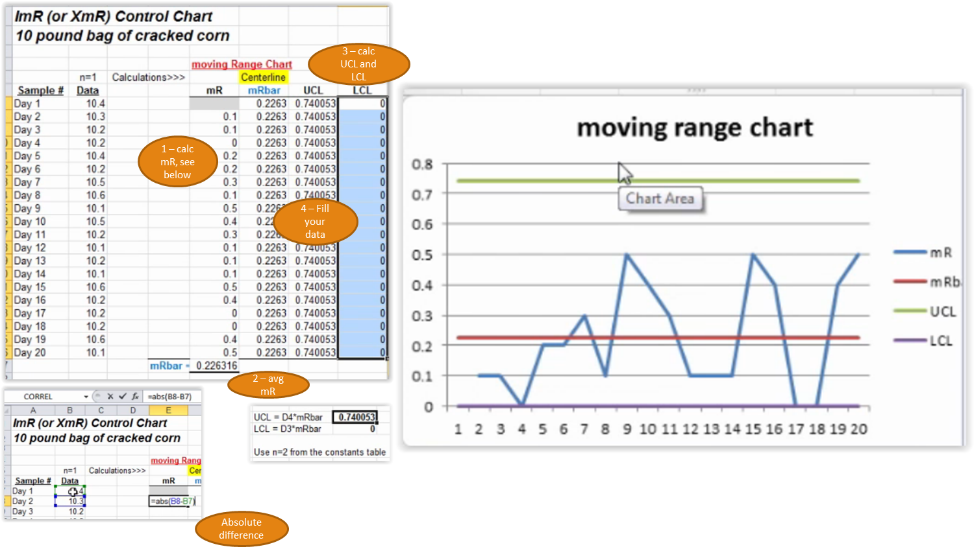
How to Build ImR in Excel

Slide 13

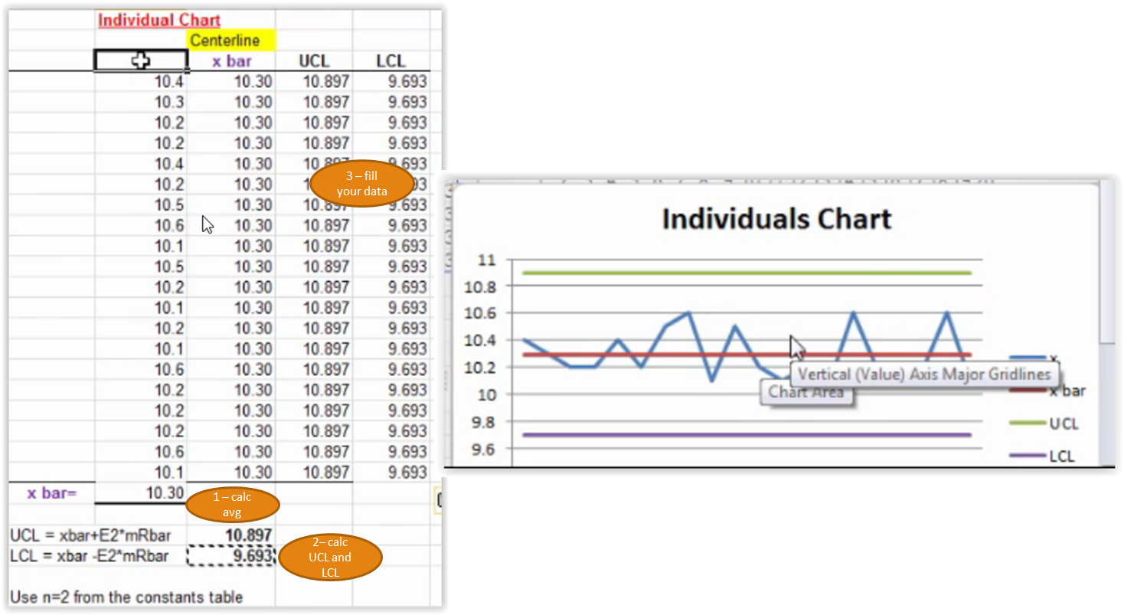
How to Build ImR in Excel

Slide 14
Super Results! Reduced process time and reduced variability. Adjusted Control Limits after process changes and after gathering future state data
Process
Improvement

Slide 15
Breakouts – Control Charts

Slide 16
Process Improvement Project Rubric
A) An executive summary is provided in the storyboard format including: Is the storyboard presented in 1 PowerPoint slide? Follows DMAIC? Are tools/graphs/charts used and clearly visible? Do they support findings and conclusions Are arrows, call-out boxes, etc. used to summarize, highlight questions and key learnings? Are expected results clear? And next steps noted? | 5
B)Is it a cohesive presentation opening with the business process and problem statement? The back-up slides (5-15) detail and support the storyboard content. | 2
C) Was the success measure clearly identified, operationally defined and baseline identified? (Was the data identified as continuous or discrete, includes SQL?) | 3
D) Was the data measurement plan or data stratification tree included? | 1
E) Was the data collection method identified? | 1
F) Was there rationale for the sample size taken? Use of the formula? Is there any reference to measurement error and how to minimize? | 1
G) Are at least 5 different tools and techniques clearly identified? Are the tools linked/ pertinent to the data analysis? | 5
H) Does the data analysis clearly tie to the problem conclusion? Is the “discovery” clear to the reader? | 2
Total possible
points = 20

Slide 17
What’s next
Class Assignments | Submit / Post Location | Due Date
Week 8 (Required Reading: Understanding Variation by Donald J. Wheeler)
Homework #5: (worth 3 points) Submit one Excel file containing this assignment: Complete Control Chart problems #1-10 on pgs 114 -116 from the Understanding Variation Book. | Coursework → Assessments | 3 days after Live Session 8 = Nov 26
Week 9
Homework #6: (worth 2 points) Submit one Excel file containing this assignment: . Complete Time Series problems - Excel data file posted in the Assessments folder | Coursework → Assessments | 3 days after Live Session 9 = Dec 3
Week 10
Process Improvement Project (with Storyboard) | Coursework → Assessments | 4 days after Live Session 10 = Dec 11
Project –Improve Phase
-Use tools
-Create PowerPoint

Slide 18
Questions?

